Slide 1
[CommunityLogo]
[Community Name]
Notes:
Hello and welcome here is what we’ll do today…
NEXT SLIDE

Slide 2
REACH Program Overview
Workshop Objectives
Provide information on the importance of knowledge sharing / communication
Support community partners and teams develop community-designed initiatives using PDSA cycles
Notes:
The objective of this first Workshop is to help you, as you launch into the new process of quality improvement.

Slide 3
AGENDA
Time | Topic | Who
9:00 | Opening Welcome / Introductions | Elder / All
9:15 | Sharing REACH Activities | Western
9:30 | Team Session – Communication Plan | QI Team
10:30 | BREAK | All
10:45 | Team Session – QI PDSA Development | QI Team
11:45 | Closing | Elder
Notes:
To This is a 3 hour session – all times are approximate
[ELDER] will start the meeting
Then we’ll do introductions of the QI team
We will do a very brief overview of REACH
Then you will work together to launch the QI thinking specifically identifying areas to be improved and developing ideas
Then there’ll be a 10-15 min break
I’ll do a short review of the PDSAs then at the second Team QI Session you’ll have a chance to plan 1 or 2 PDSAs
Then [ELDER] will close

Slide 4
[insert community photo]
Elder Opening
[Name of Elder]

Slide 5
[QI Team Photo]
Introductions
Notes:
Some of us have met before but it has been awhile
It would be great if everyone introduces themselves and maybe shares/describes their favourite place in the community or a special event unique to your community
We’ll start with Carlene ….

Slide 6
Sharing REACH Activities

Slide 7
Communication of REACH Activities
What is communication?
Communication is the transmission of ideas and information
Notes:
The objective of this first Workshop is to help you, as you launch into the new process of quality improvement.

Slide 8
Communication of REACH Activities
Why Communicate?
To share success
To relay status/progress
To raise awareness
To develop trust
To maintain project momentum / progress
To share frustrations / barriers
To obtain funding
Notes:
The objective of this first Workshop is to help you, as you launch into the new process of quality improvement.

Slide 9
Communication of REACH Activities
Who Needs to be Informed (Audience)?
Community members
Clients/Patients
REACH PDSA participants
Healthcare colleagues
Healthcare leadership
Community leadership
Regional organizations
Funding organizations
Notes:
The way the message is communicated is best to align with the audience. The same message could be stated in a different manner
FOR EXAMPLE…… ADD SLIDE???
Blood sugar not A1C

Slide 10
Communication of REACH Activities
What to Communicate?
Status / Progress of REACH QI Program
PDSA results
Planned PDSAs
QI Team meeting minutes
REACH evaluation findings
Notes:
Use example –
QI Team meeting minutes to leadership / supervisor – summary or actual meeting notes

Slide 11
Communication of REACH Activities
How do you deliver your message?
Direct, written methods
Text, Email
Letters / Newsletters
Reports
Direct, face to face methods
Speeches
Conversations
Visual methods
Posters / Storyboards
Slide presentation
Public methods
Website
Social media (Facebook etc.)
Notes:
Think about you will share the results of your hard work on the PDSAs…..
How would you share EXAMPLE1….
How would you share EXAMPLE2

Slide 12
Communication of REACH Activities
When do you deliver your message?
Regularly
Monthly
Quarterly
Occasionally
End of PDSA
End of Action Period
End of REACH QI Program
Notes:
Regularly imposes structure and provides a due date
Occasionally is event driven

Slide 13
Communication of REACH Activities
Where do you deliver your message?
Council meetings
Staff meetings
Clinic spaces
Schools
Community centres
Community Events
Local sites
Regional meetings
Conferences
Notes:
Local sites = pharmacy / health centres
Community events = health fairs / pow wows / elders lunches

Slide 14
Communication of REACH Activities
Step-by-Step - Communication Process
Determine the objective of communication
Define who needs to be informed (audience)
Develop key messages
Develop communication material
Deliver communication
Obtain feedback
Notes:
Define who needs to be informed
Determine the objective of communication
Is it education / information only
Are you trying to persuade – change someone’s mind
Are you making a request (funding / space)
Define who needs to be informed (audience)
Develop key messages
Make sure your message matches your audience
Get feedback so that message is clearly stated
Develop communication material
Do you need to bring in someone with expertise
Deliver communication
If applicable, match presenter with the audience
Obtain feedback – treat it like a PDSA –
Obtain audieince views or feedback
revise for next communication

Slide 15
Communication of REACH Activities
Why Develop a Communication Plan
Simplifies the task of communication
Maps the target audience in the right place, at the right time, with the right message.
Allows the team to communicate with a unified voice
Makes your communication efforts more efficient, effective, and lasting
Notes:
Using a structured method to ensure that you consider all the important things to take into consideration ie audience
Makes it possible to target your communication accurately

Slide 16
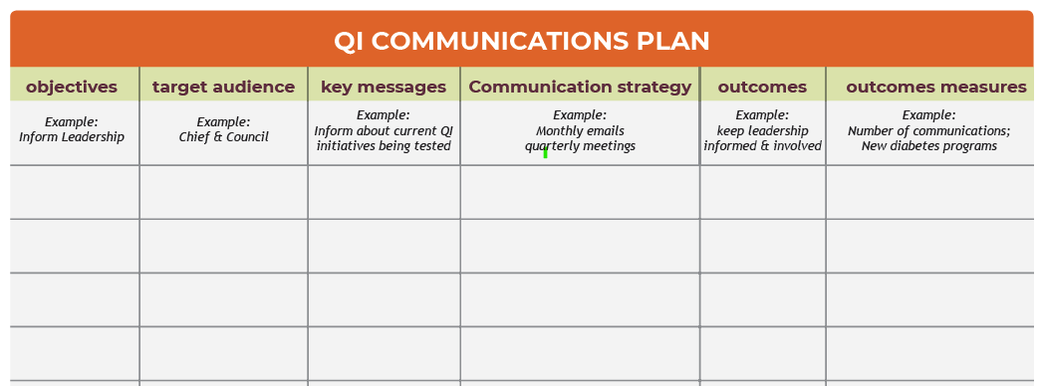
Why communicate
What to communicate
Who needs to be informed
How / Delivery Method
When / Frequency

Slide 17
Communication of REACH Activities
Communication Planning
Align the message with the objective
Match the method with the audience
Consider the reality of time constraints
Plan for obstacles
Notes:
for example don’t write a report when an email will do
Don’t let perfection stand in the way of good

Slide 18
[insert community photo]
Team Session
Communication Plan

Slide 19
Team Communication Session
Complete the Communication Plan
Determine the objective of communication
Define who needs to be informed (audience)
Develop key messages
Decide how, when, and where
Decide how you will evaluate
Notes:
The objective of this first Workshop is to help you, as you launch into the new process of quality improvement.

Slide 20
[insert community photo]
BREAK
Notes:
Its time for our 10-15 minute break we’ll start again at XXXXX

Slide 21
[insert community photo]
Team Session
QI PDSA Planning

Slide 22
Team QI Session
Notes:
The PDSA cycle worksheet may be helpful to document your plan and keep track of your notes and results during the DO your discussion in the STUDY and your decisions in the ACT phases
It is also a way to provide information Jim so he provide support.

Slide 23
Team QI Session 2
Notes:
The PDSA cycle worksheet may be helpful to document your plan and keep track of your notes and results during the DO your discussion in the STUDY and your decisions in the ACT phases
It is also a way to provide information Jim so he provide support.

Slide 24
Next Steps
Your third QI Action Period starts tomorrow!
Be sure to capture your plans, progress & success
Remember you have support from the REACH Program Team
Sustainability discussion at the end of Action Period 3

Slide 25
Reminder to Complete the Workshop Evaluation Form
Notes:
READ SLIDE
WE WILL BE SENDING YOU A VERY BRIEF ANONYMOUS WORKHSHOP EVALUATION SURVEY TO OBTAIN YOUR FEEDBACK

Slide 26
[insert community photo]
Elder Closing
[Name of Elder]

